Slide 1

Mei
AI assistants for
mobile subscribers
AI they can call or text.
AI that answers calls for them.
Operator overview | October 2026
Notes:
Mei operator overview. October 2026. Company and product relationship confirmed by Mei founder: Mei is the company; Voxie is a product; the shared AI platform powers the generative AI products. Public overview: https://www.textmei.com/ai-for-telecoms

Slide 2
Mei’s platform and two subscriber services
Mei is the company. Our shared AI platform provides agent-building tools
and the backend that powers our generative AI products.
AI subscribers talk to
AI that answers for them
Everyday questions, learning and advice
through a familiar number or short code.
Voxie is a public product example.
eYano is an operator-branded service.
Answer selected incoming calls, ask the
caller’s purpose and deliver a summary.
Configured with subscriber preferences,
operator routing and agreed actions.
Both services can be offered under the operator’s brand.
Notes:
Company/product relationship supplied by Mei founder. Service scope: https://www.textmei.com/ai-for-telecoms. Personal call handling is configured for an operator pilot; not presented as an existing MTN deployment.

Slide 3
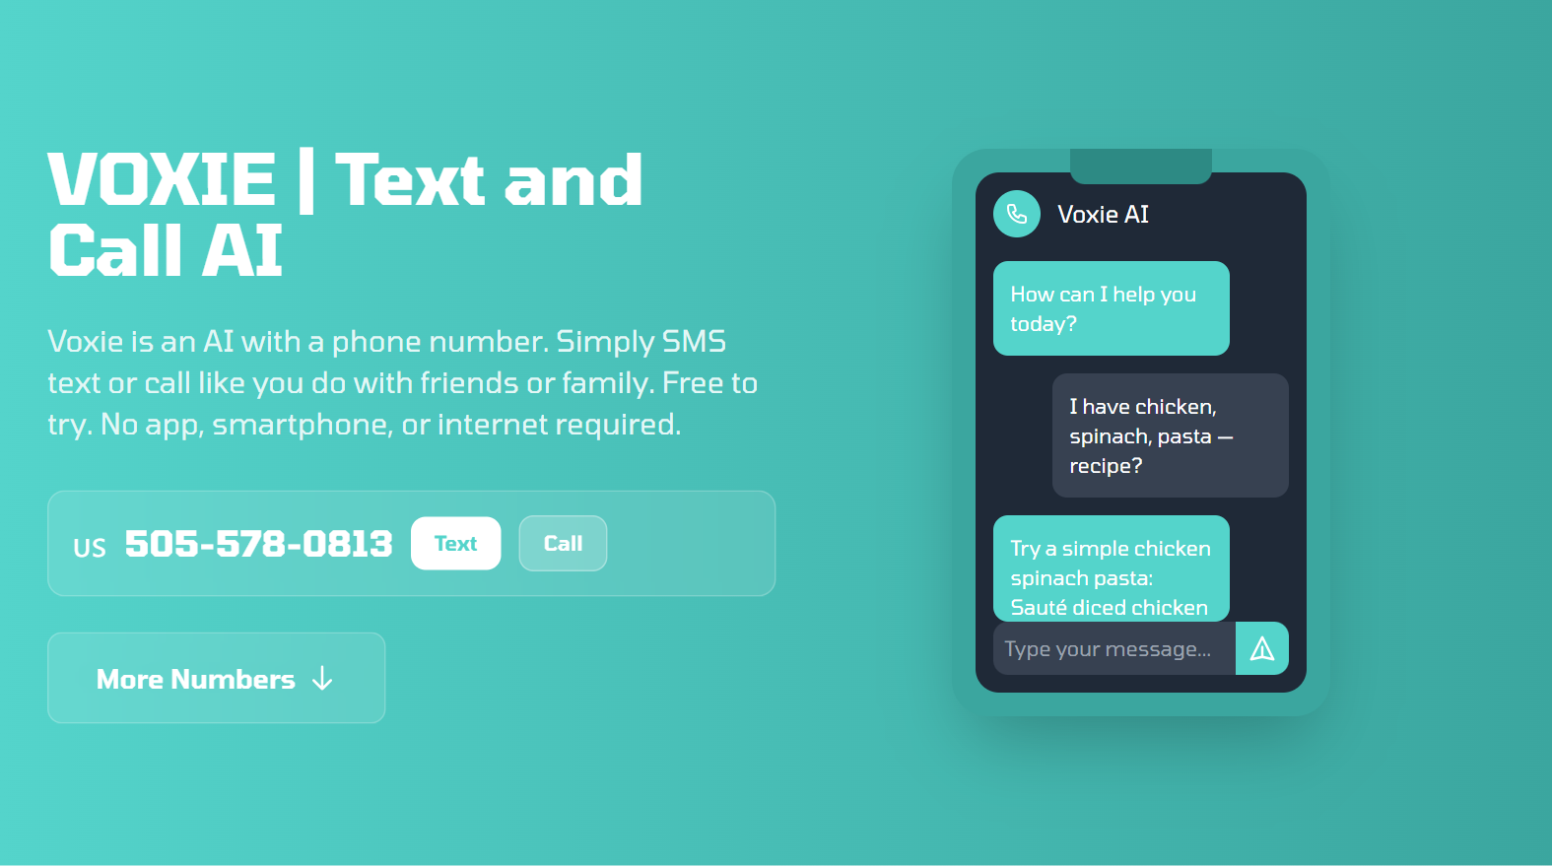
The subscriber experience
Use a familiar number
Text a question or call the AI.
Receive a reply through
that same channel.
No app or mobile data is needed
for SMS and ordinary calls.
Explore Voxie: voxie.network | Public numbers have regional access and usage limits.
Notes:
Source and screenshot: https://voxie.network/ captured October 2, 2026. Public directory describes geographic access restrictions. No test calls or texts were sent. The phone UI on the site is an illustrative product example.

Slide 4
A personal call assistant
The call flow
Illustrative delivery call
1. Subscriber chooses when AI answers.
2. Operator routes an eligible call.
3. AI captures the caller’s purpose and
follows agreed message or transfer rules.
4. Subscriber receives the summary.
“I’m delivering a package.
May I leave it at reception?”
What the subscriber receives
A short recap of who called,
what they needed and any
agreed next step.
Recordings, transcript access and follow-up use the subscriber’s settings and service rules.
Notes:
Illustrative operator workflow. Platform source reviewed: voice_app.py, voice_session.py and transports.py in Mei’s backend code. Routing, subscriber identity, notifications, recording policy and calendar integration require deployment-specific configuration. Public capability overview: https://www.textmei.com/ai-for-telecoms

Slide 5
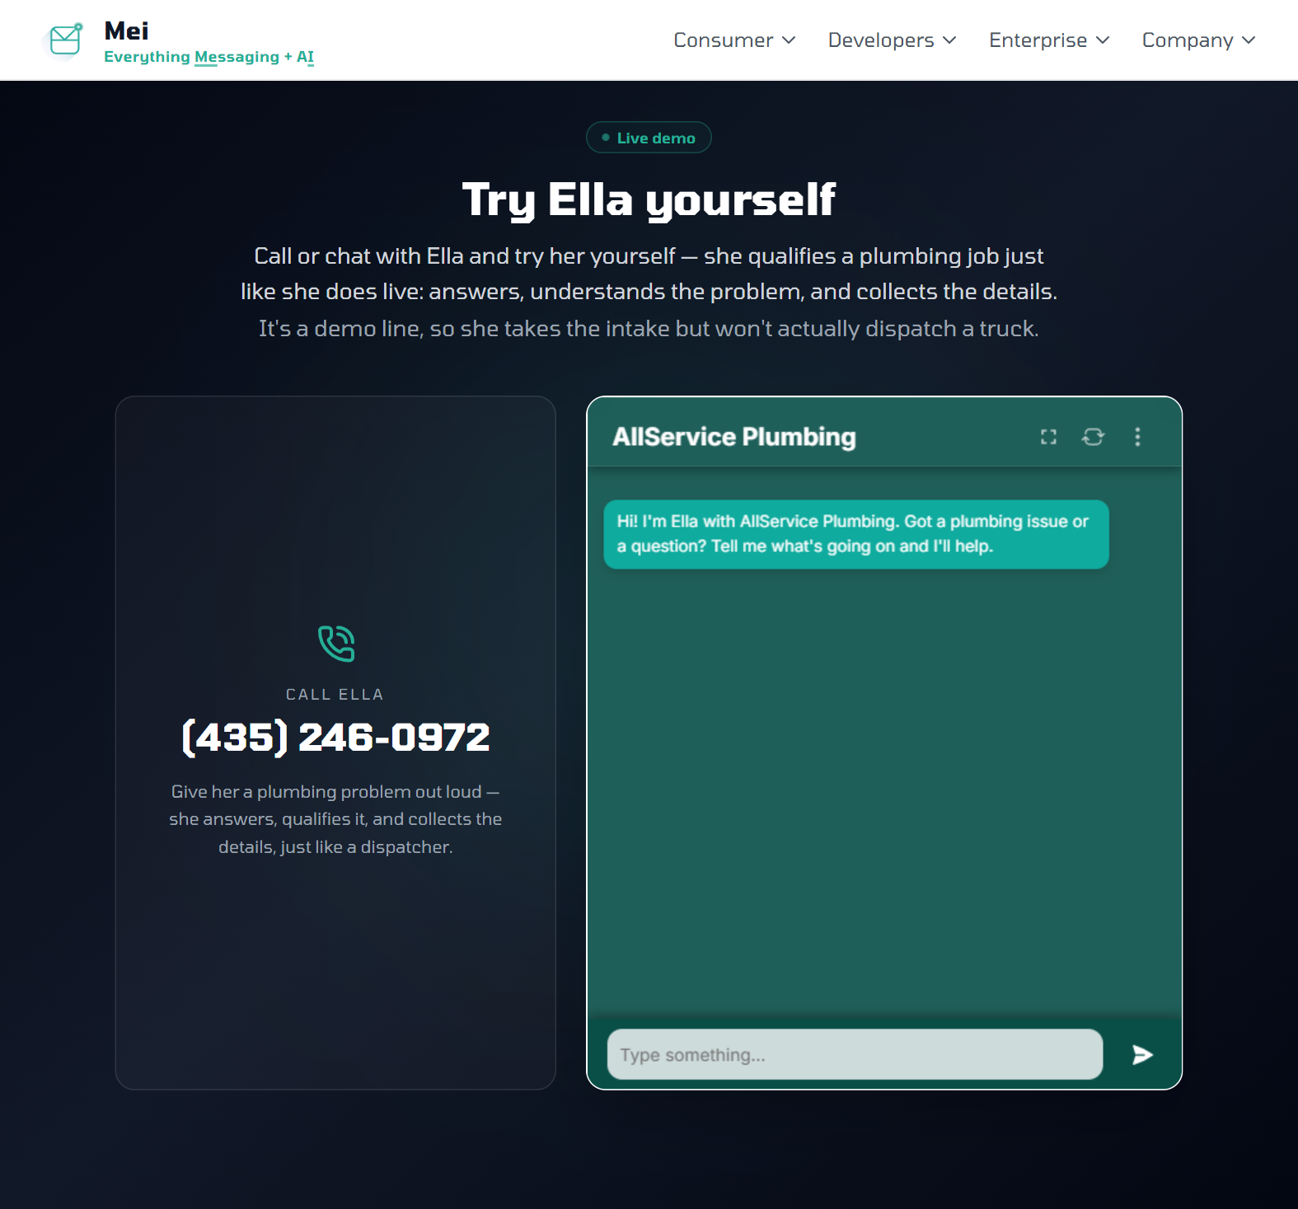
Conversations that lead to actions
Ella: a related business example
Answers a voice call and collects
the details needed for a job.
Connects those details to a booking
workflow through ServiceTitan.
Shows how the same AI platform can
link conversation to a permitted action.
Personal calendar booking is scoped to the
chosen calendar and user authorization.
Explore the workflow and public demo: textmei.com/case-studies/ella
Notes:
Source and screenshot: https://www.textmei.com/case-studies/ella captured October 2, 2026. Ella is a home-services business intake agent with a ServiceTitan integration. The public demo collects intake and does not dispatch a truck. This is evidence of related platform capabilities, not a consumer calendar service.

Slide 6
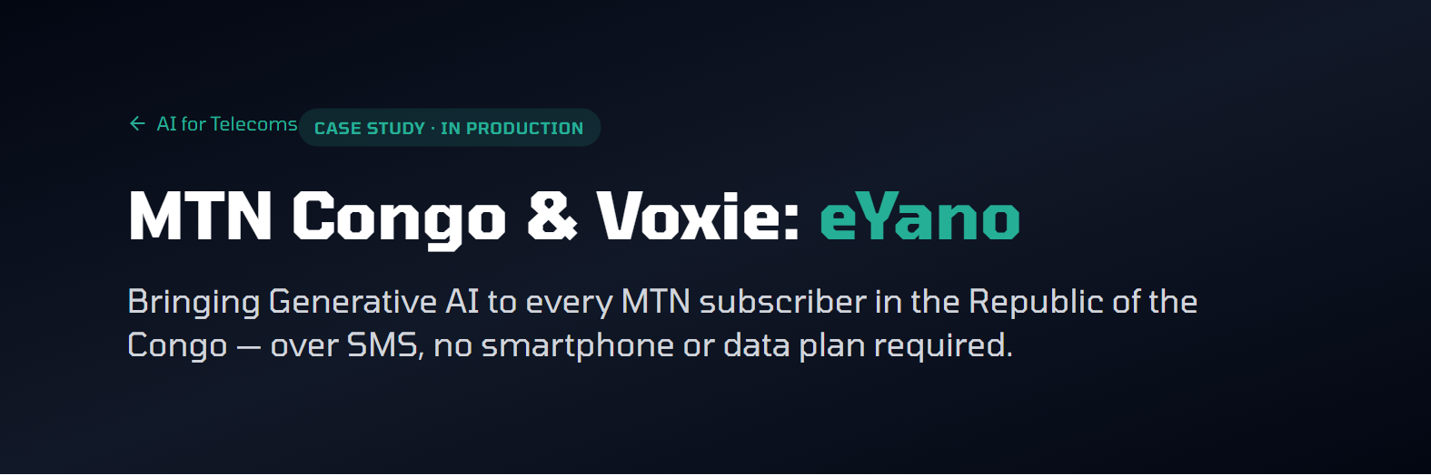
Operator deployment: eYano on MTN Congo
Republic of the Congo
AI under the operator’s brand,
delivered over SMS.
Works through the carrier’s
existing SMS channel.
Basic phones can use it.
No app or data plan is needed.
Read the deployment story: textmei.com/ai-for-telecoms/case-studies/mtn-congo-eyano
Notes:
Source and screenshot: https://www.textmei.com/ai-for-telecoms/case-studies/mtn-congo-eyano captured October 2, 2026. Operator integration also confirmed by Mei founder and backend source. SMS reference only; does not establish deployed personal call answering. No performance or subscriber-volume claims included.

Slide 7
Integration and service ownership
Area | Mei’s platform | Operator / joint configuration
Access | Voice, messaging and service APIs | Network routing and subscriber identity
AI behavior | Agent configuration, models and tools | Brand, knowledge and target-language tests
Subscribers | Conversation and action handling | Preferences, recordings and delivery channels
Actions | Connections to permitted workflows | Calendar / business access and authorization
Billing | Agreed service integration | Activation, billing and usage allowances
Agree the interfaces and responsibilities during pilot scoping.
Notes:
Platform responsibilities based on internal architecture review and https://www.textmei.com/ai-for-telecoms. The table is a proposed division to be agreed with the operator, not a claim that every network interface is already implemented.

Slide 8
Subscriber revenue options
An included allowance
Paid top-ups
Let subscribers try the service or include
messages and minutes in an existing plan.
Sell additional usage after the included
allowance is used.
A monthly add-on
Optional sponsored content
Offer a recurring AI plan or include
the service in a premium bundle.
Consider relevant business recommendations
where they fit the service and market.
Illustration: paying subscribers × retail subscription price = gross subscription revenue
Operator fees and partnership terms are discussed privately.
Notes:
Illustrative subscriber revenue model. No operator pricing, cost amounts, forecast adoption or margin claims. Based on the authorized telecom brochure commercial section. Retail pricing and usage allowances are chosen by the operator; fees and partnership terms are discussed privately.

Slide 9
Define an operator pilot
Choose the subscriber experience
Confirm the starting requirements
A call/text assistant, a personal call assistant,
or a limited group testing both.
Language and subscriber group
Call routing and subscriber identity
Summary delivery and recordings
The first action or integration
Agree what a successful pilot measures
Call quality, useful responses, completed tasks,
subscriber feedback and repeat use.
Es | Founder, Mei | es@textmei.com
textmei.com/ai-for-telecoms/details
Notes:
Pilot discussion framework for prospective mobile operators. No commitments on implementation timeline, unsupported languages, rollout scale or commercial price. Contact provided by Mei founder: es@textmei.com. https://www.textmei.com/ai-for-telecoms

